Slide 1
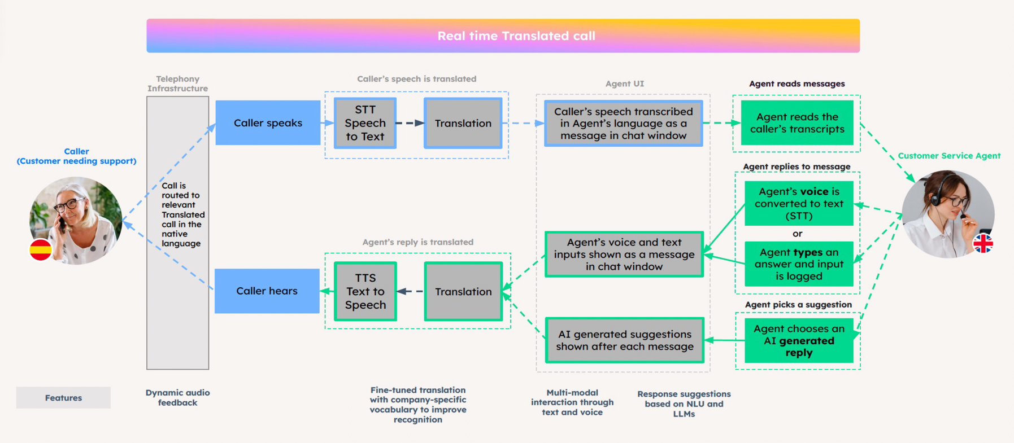
The Age of Generative CX
Translate

Slide 2


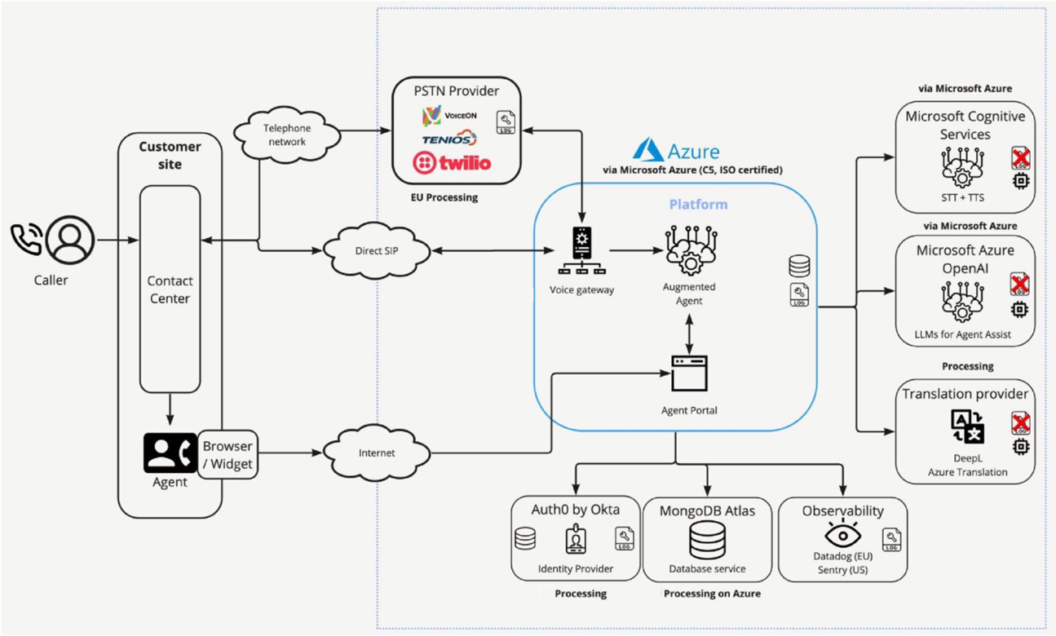
The Age of Generative CX
Technical Architecture

